Slide 1

Speed Breaker Accident Control
Team Name: Solution Makers
Presented By
Venkata sai vardhan. T – 19JR1A05I2
Pavan Kalyan. T – 19JR1A05I1
Kartheek Babu. P – 19JR1A05G4
Mahaboob Subhani. SK – 20JR5A0512
IoT Hackathon 2019

Slide 2
Problem Statement
Problem statement:-
Occarance of Accidents at Speed Breakers and some important places
Basically everyone here likes travelling , So some of the crew had planned to go some place.. Since it is a jolly trip everyone used to enjoy even though the driver too..
At that time and mood the person who drives the vehicle may not observe the speed breakers and move on with a drastic speed which causes the major accidents(especially motor cycles)
Let us have to think that what will happen when this occur at schools and temples …. SO SAD
IoT Hackathon 2019

Slide 3
Customer Survey
We had done a survey by the help of Google Form, We got some experiences which threaten us
We guys met some of the persons who faced this situation and noted their worst experience
Link:-
https://docs.google.com/spreadsheets/d/1v3T7SI0HMNQTKJQKsl-BOiTxQsflE1hvS6au6jhC6fQ/edit?resourcekey=null#gid=1238737256
IoT Hackathon 2019

Slide 4
Existing Solutions
There is the Existing solution called “SIGN BOARD” which indicates the presence of Speed breaker at side of the road and presence of school and temple
Some of the members who only concentrate on driving can identify that board and can reduce the speed , What about the people who was not concentrate?
The thing “SIGN BOARD” is a good thing for some people like mentioned above , we have to improve that everyone even though who doesn’t concentrate on driving may have to know that there is a presence of speed breaker and some important places like schools, temples etc..
IoT Hackathon 2019

Slide 5
Our Solution
We are having an wonderful and useful solution for that situations and most of the customers felt very happy when we expressed our solution
Now-a-days most of the vehicales have displays , We will produce an alert with display and some sound
It gets active the driver to take some actions
IoT Hackathon 2019

Slide 6
Value Proposition
Our product is very small in structure , Since it is very easy to implement in Vehicles
It will attacks the Customer more , Because the alert message and sound we produce makes person to get alert unless the existing one is only used as the person only have to identify the presence of Area
Our product will be delivered in all the vehicle shops and we make the upcoming vehicles as Inbuilt Feature
IoT Hackathon 2019

Slide 7
Customers & Consumers
Every person who own and drives the vehicle are the customers of our Product and govt
Our product will be purchased by all the Automobile shop dealer and get implemented in Vehicles
Our main segments are :-
1. Showrooms
2. Automobile Shops
3. Government
IoT Hackathon 2019

Slide 8
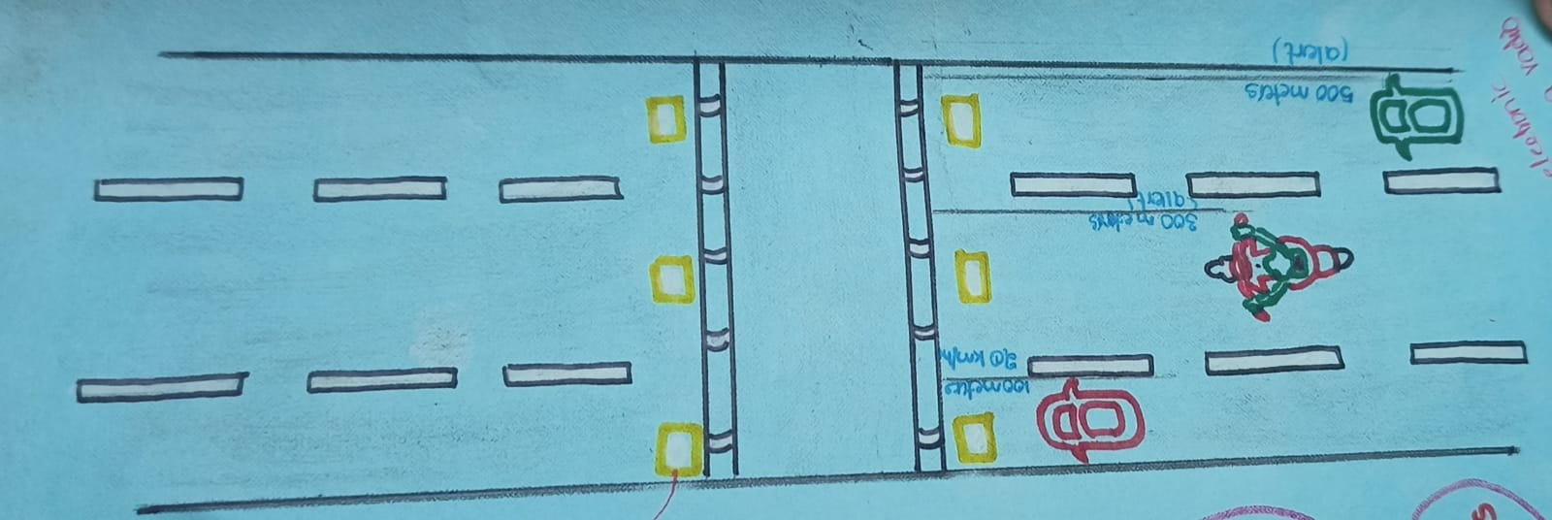
Design - Blueprint
We want to prepare prototype in which functions as same as the existing one
If time permits, I will spare my personal time and try to complete , but we are sure the we will complete the prototype within time
IoT Hackathon 2019

Slide 9
Thank You! We are happy to hear your feedback as well, we would come back stronger!
IoT Hackathon 2019

